Slide 1
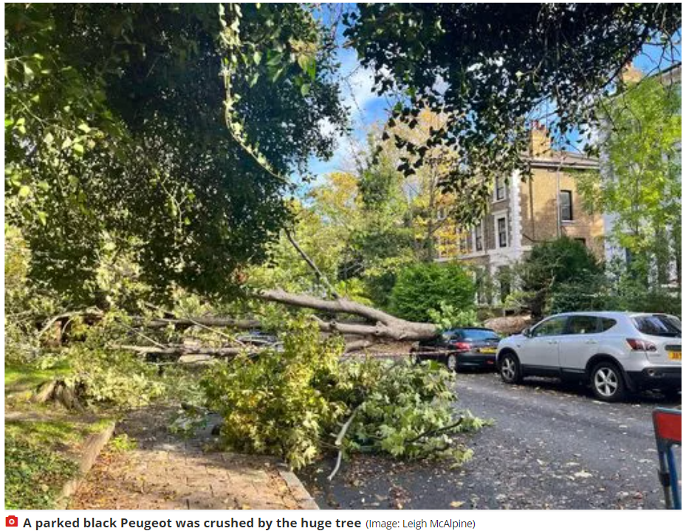
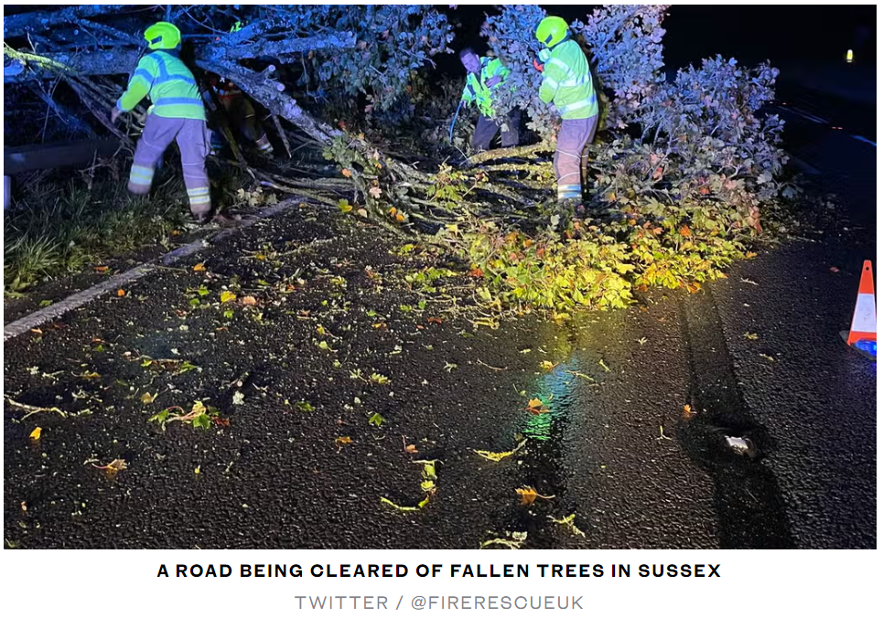
Wind Damage: Sussex - London
London and SE England Bow Echo
The London fire brigade experienced “a large spike” in calls
between 1700 and 1900 BST, with 5X more calls than the 5-year
average: 84 calls for flooding, 105 calls for fallen trees, 11 for fallen
objects.
Courtesy of MyLondon News:
https://www.mylondon.news/weather/
london-weather-live-capital-battered-25333409
Courtesy of The Standard:
https://www.standard.co.uk/news/london/
london-weather-storm-fire-brigade-b1034815.html

Slide 2
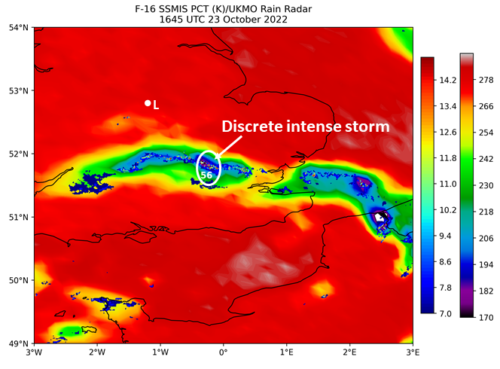
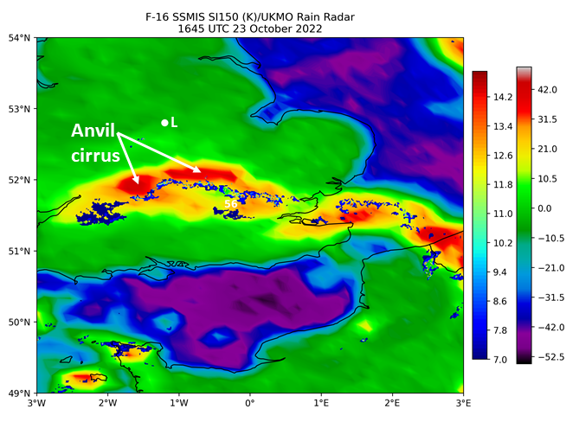
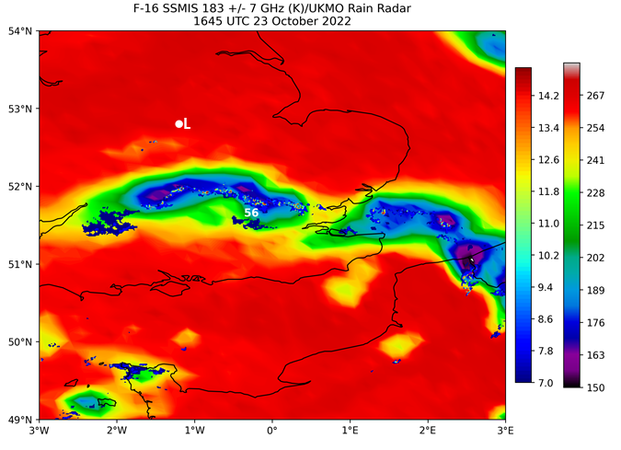
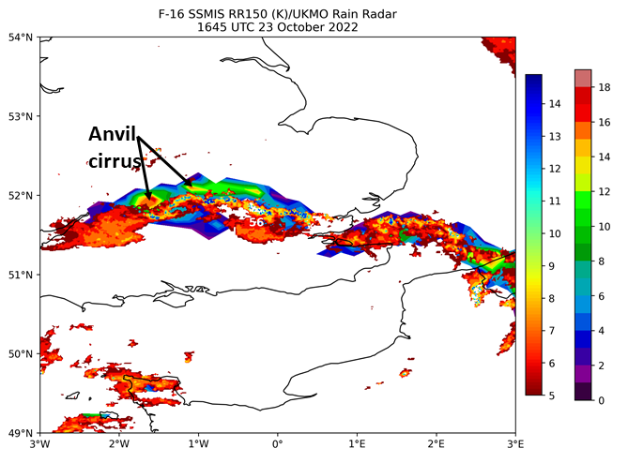
SSMIS-Radar Product Comparison
L

Slide 3
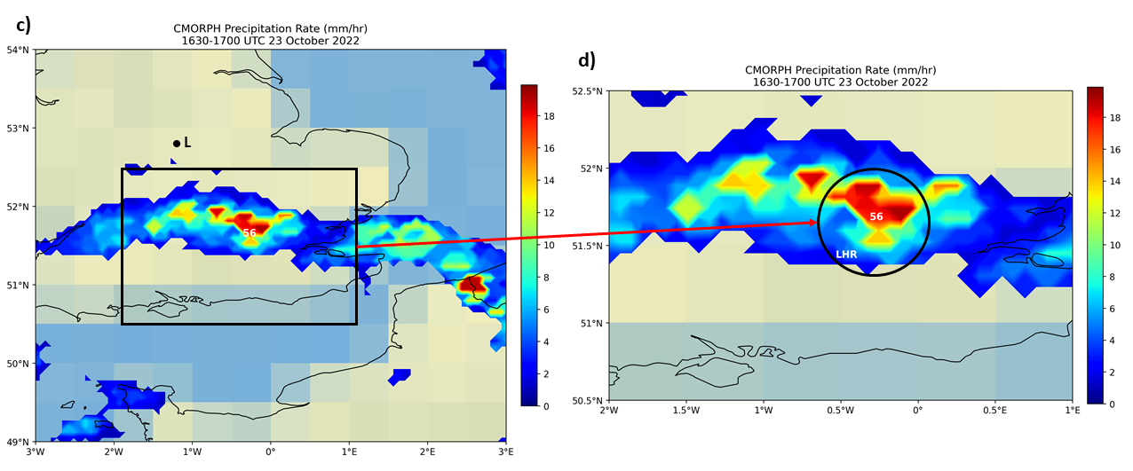
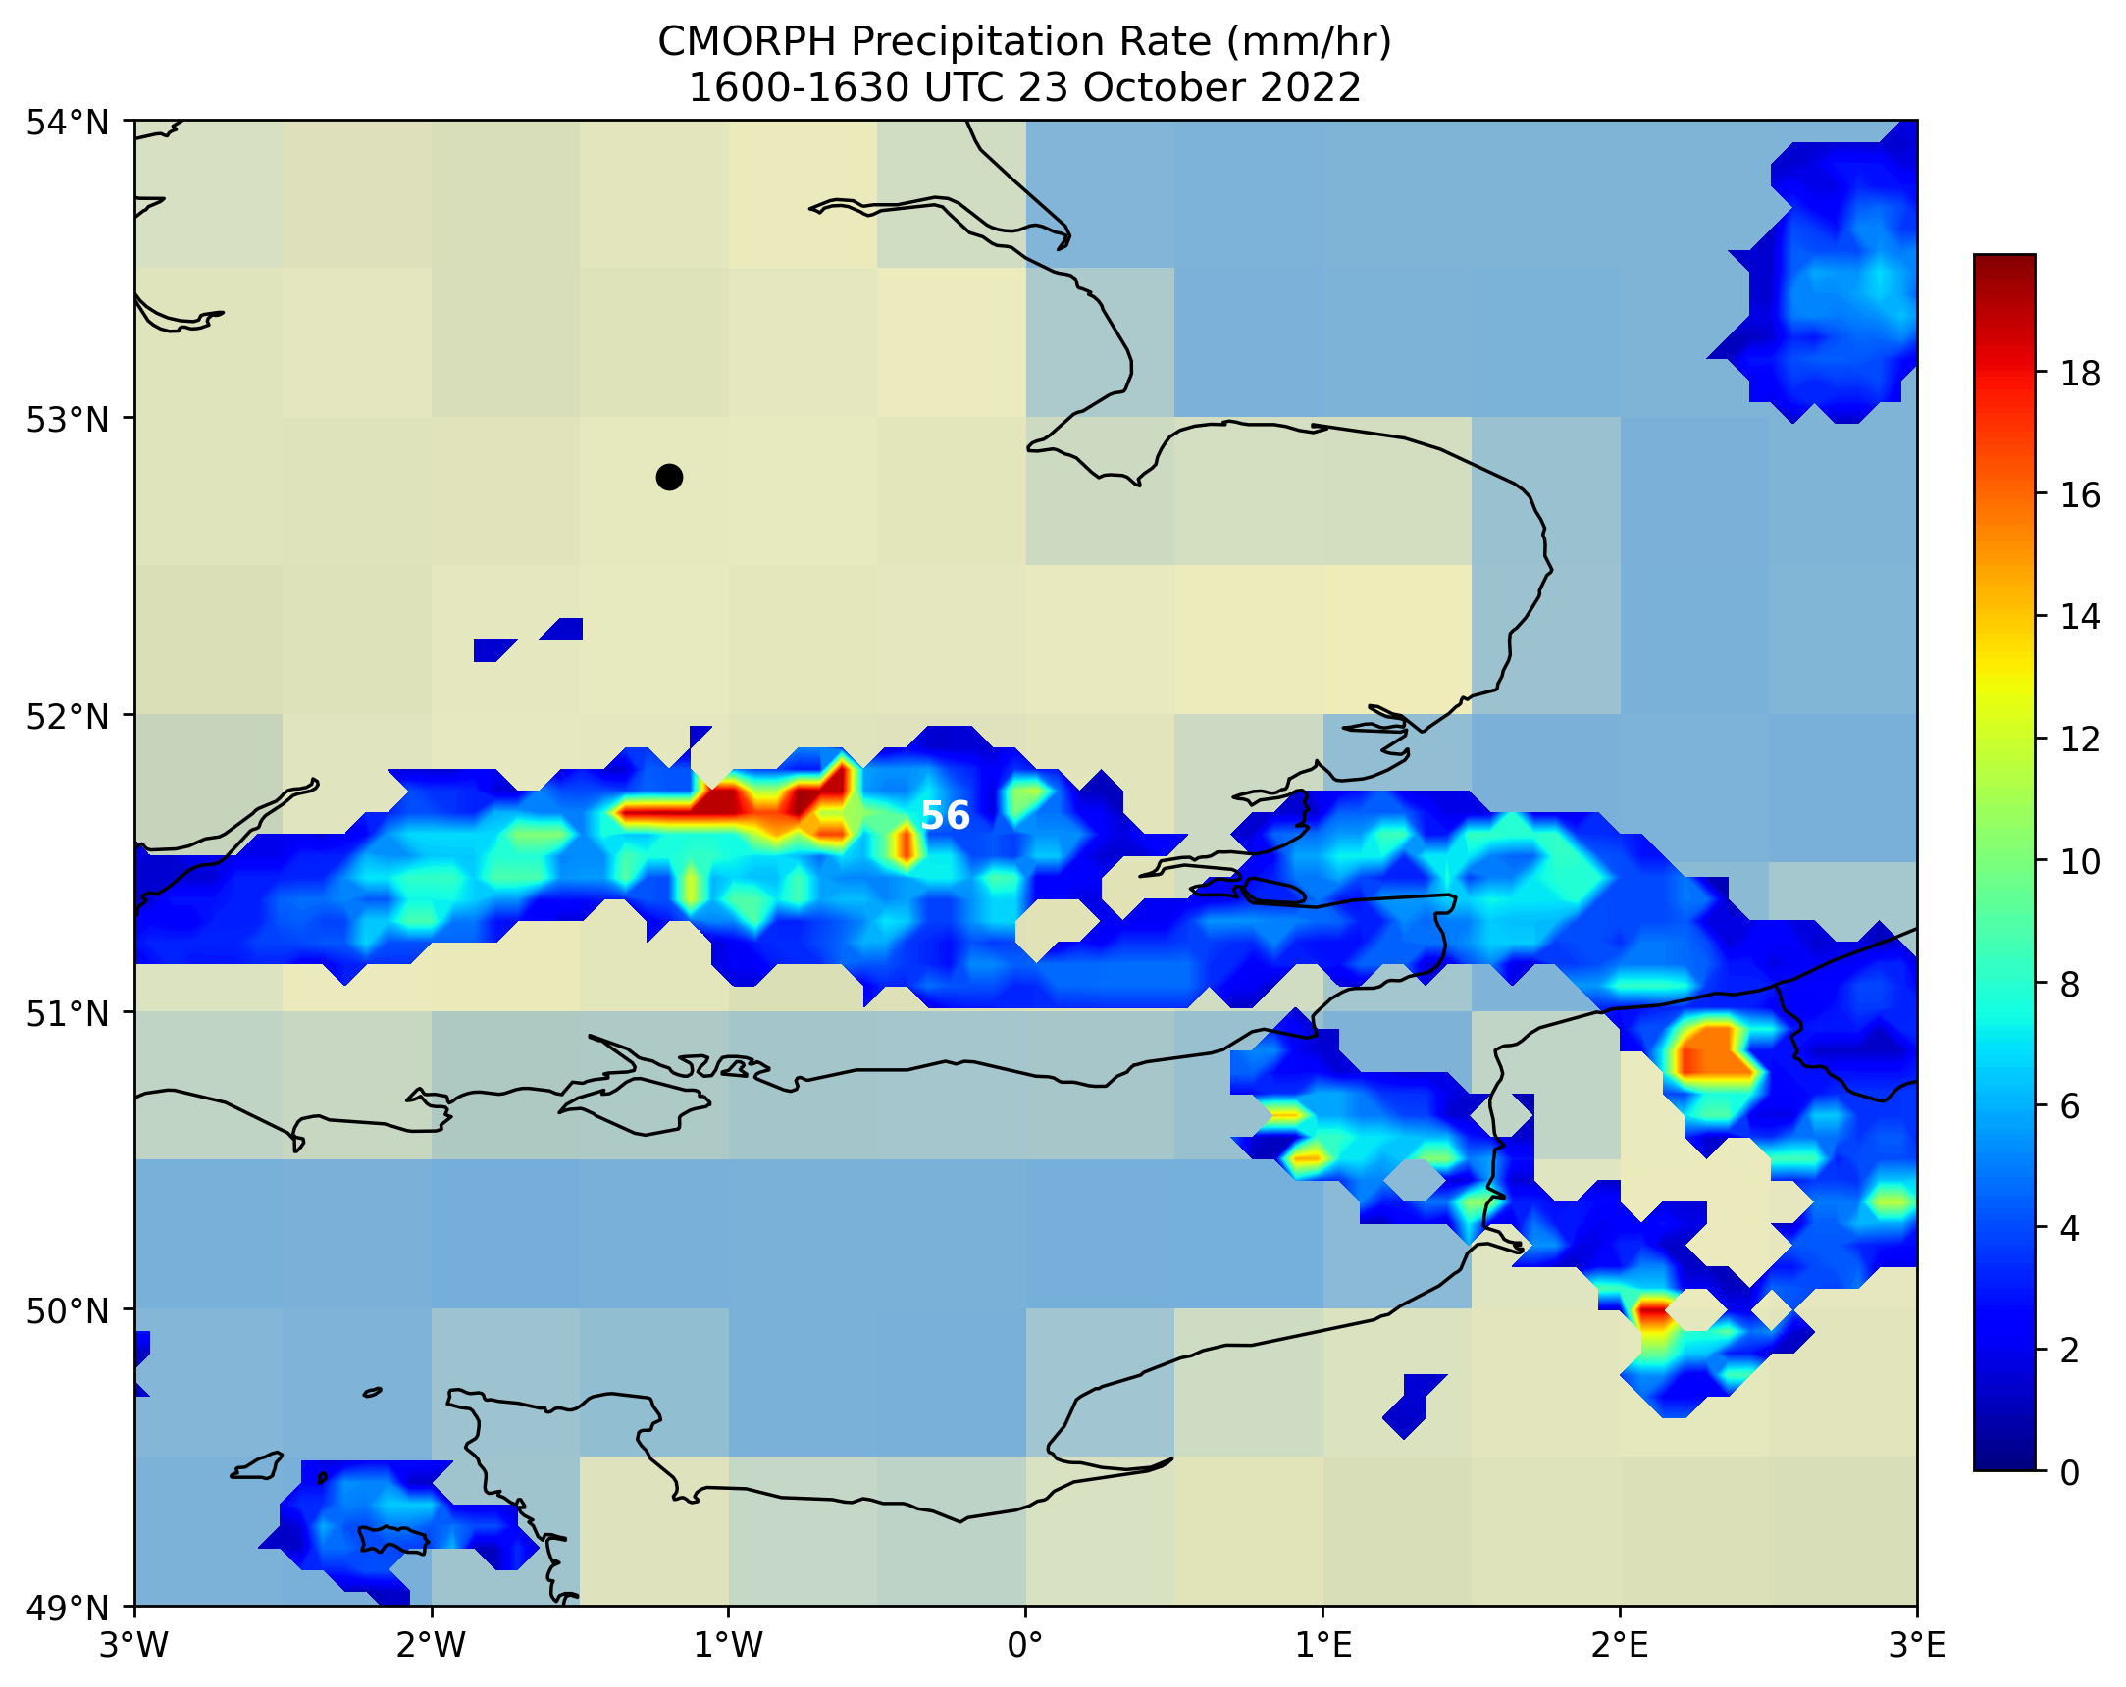
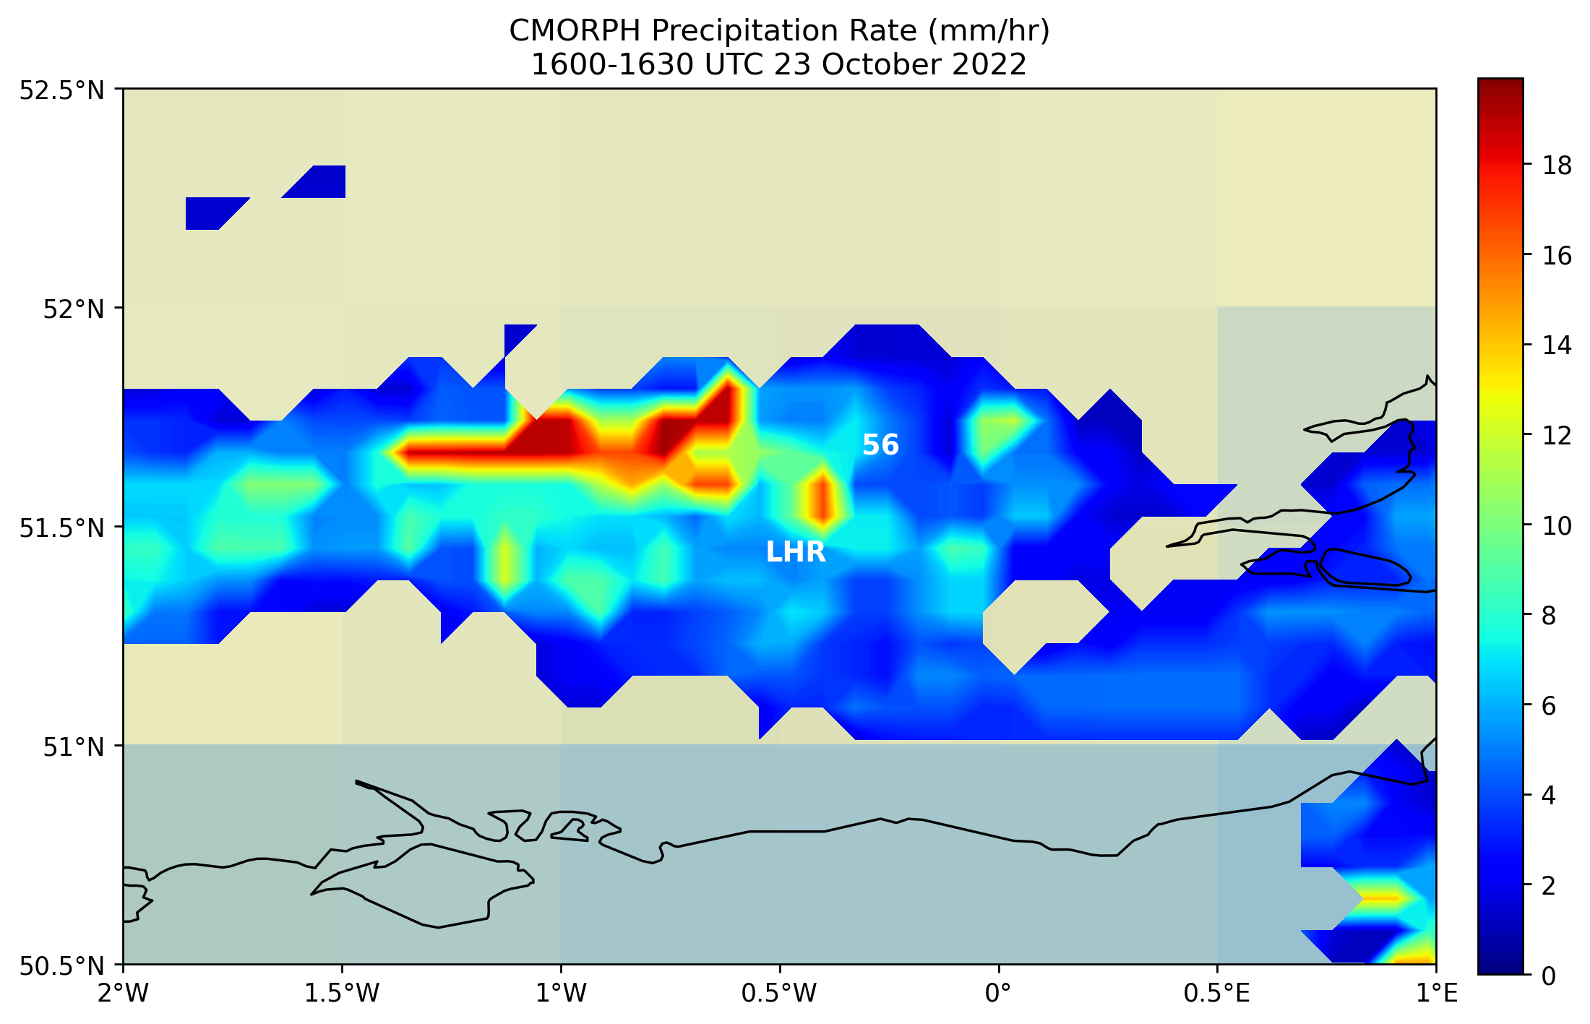
Satellite Passive MW-derived Rainfall Rate
a)
b)
L

Slide 4
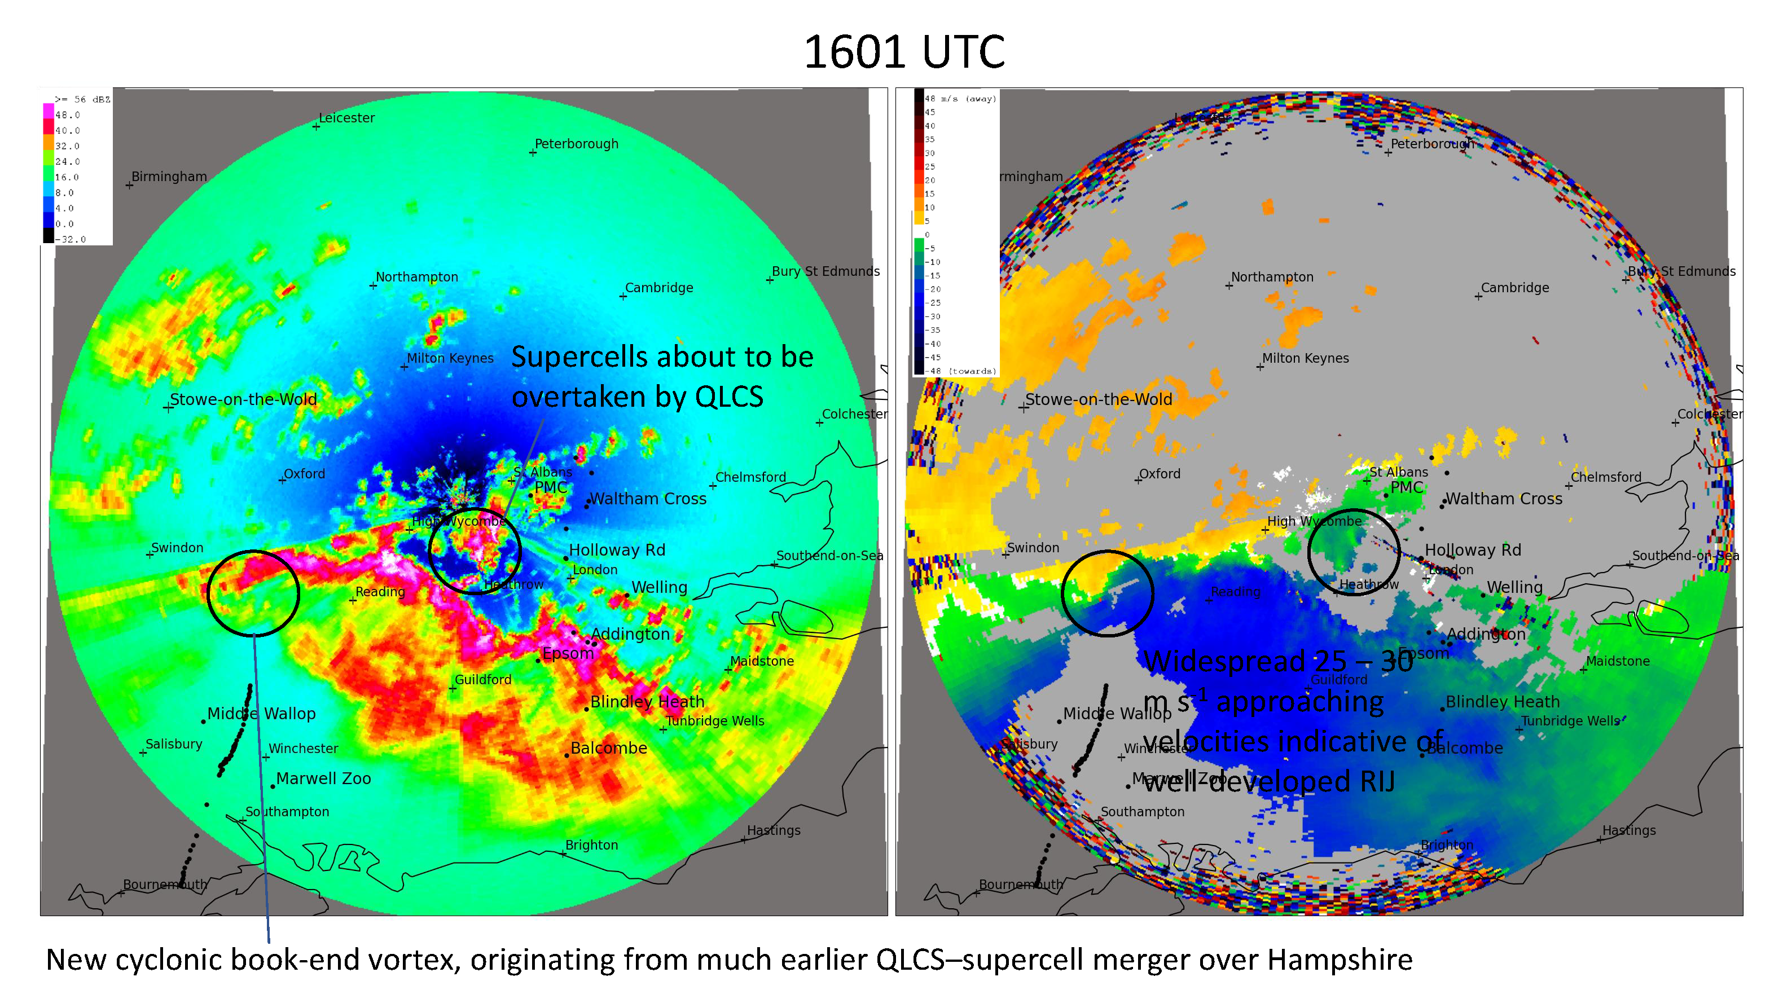
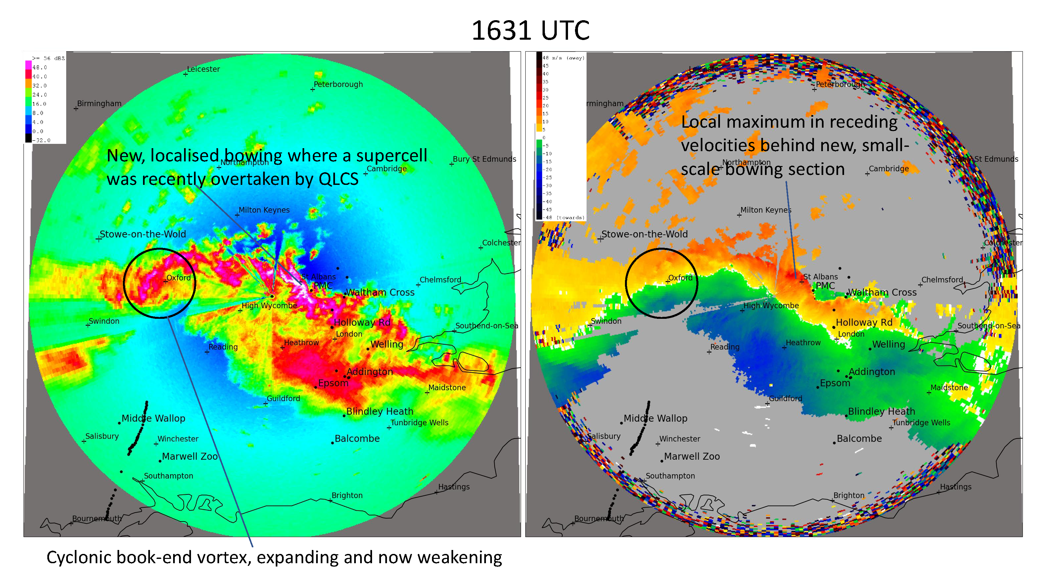
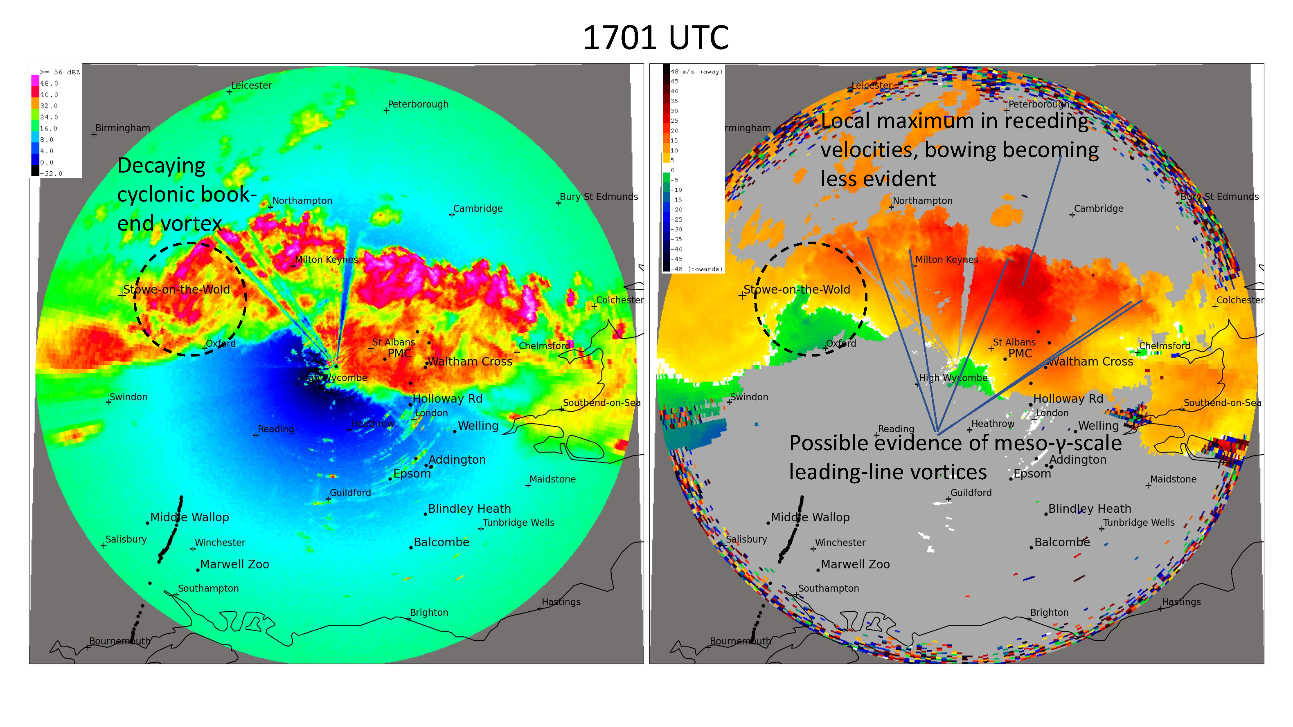

Slide 5
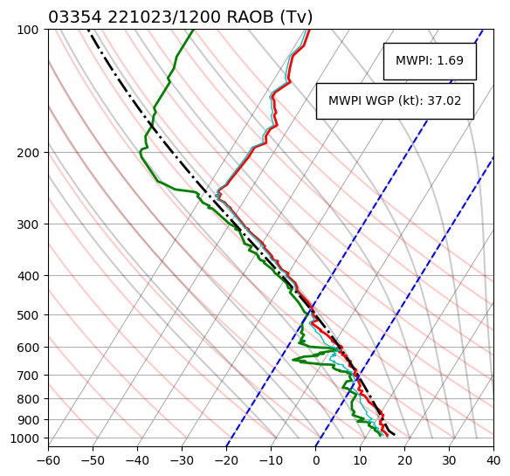
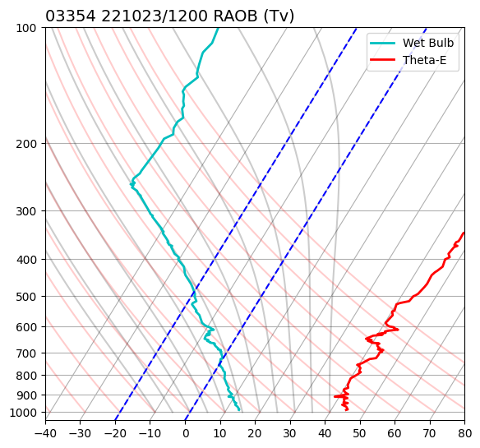
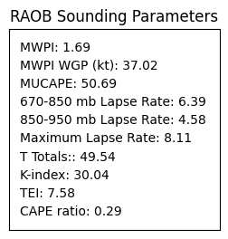
RAOB Sounding: Nottingham, UK
c)
d)
WGP + 15.3 = 52.3 kt
Optimal for strong convective winds
LCL height = 224 m
WBZ
Conditional/potential instability

Slide 6
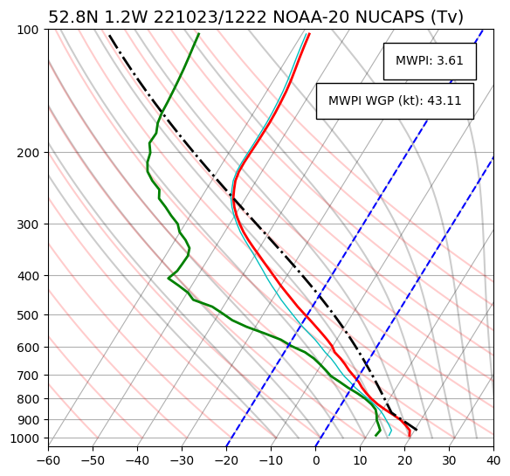
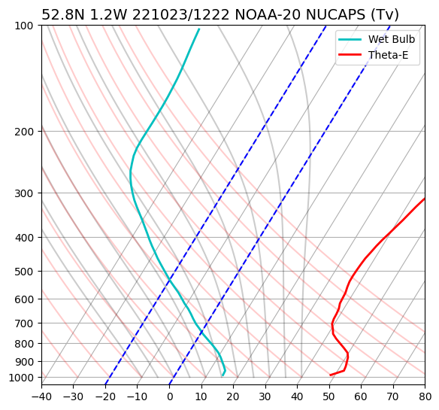
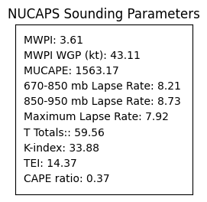
NOAA-20 NUCAPS: Loughborough, Leicestershire, UK
c)
d)
WGP + 15.3 = 58.4 kt
Optimal for strong convective winds
LCL height = 1153 m
Potential instability
WBZ
Conditional instability

Slide 7
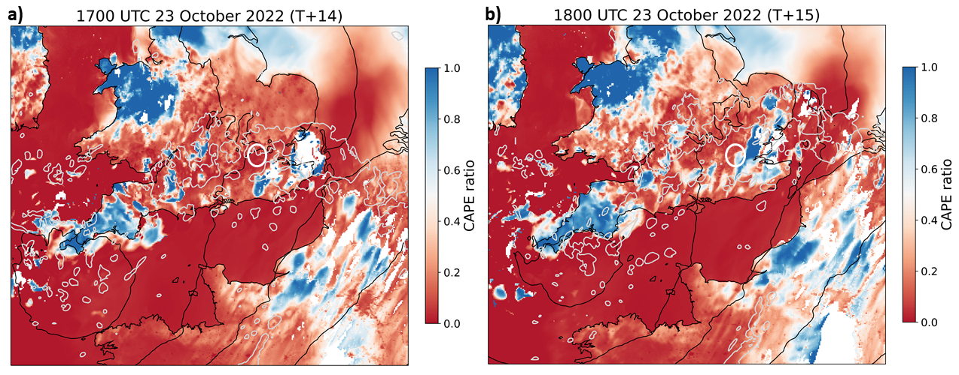
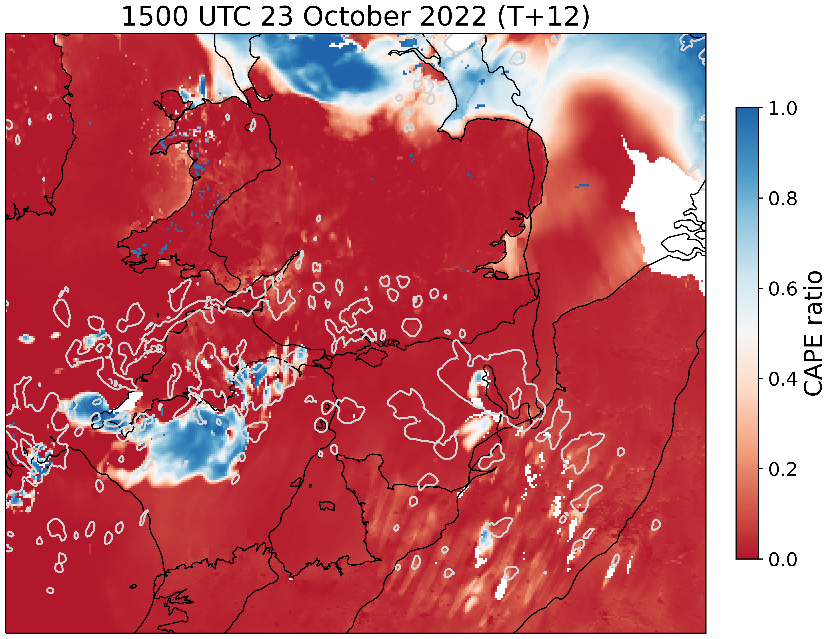
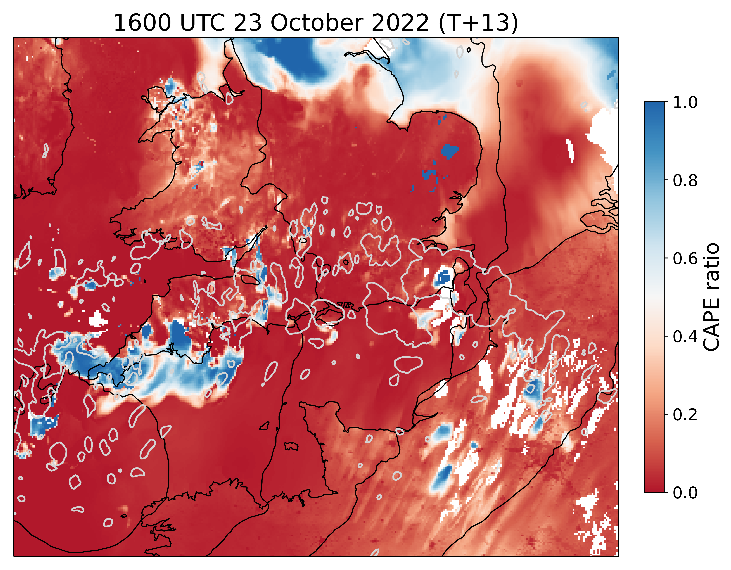
Elevated convection diagnostic: CAPE Ratio
a)
b)
CAPE ratio diagnostic = 1 - (SBCAPE/MUCAPE)
Courtesy Dr. David Flack, Met Office
Flack, D.L.A., Lehnert, M., Lean, H.W., and Willington S. (2023) Characteristics of Diagnostics for Identifying Elevated Convection over the British Isles in a Convection-Allowing Model. Wea. Forecasting 38: 1079-1094

Slide 8
Summary and Conclusions
Mapped SSMIS imagery with UKMO rain radar overlays and mid-day NUCAPS sounding profiles over W. Sussex and Leicestershire (~90 miles NW of London), provided the strongest signal for severe downburst winds in the pre-storm environment:
LCL heights near 1000m and wet-bulb zero heights between 700 – 750 mb.
Close agreement between the boundary layer structure ("inverted-V") as resolved by the NUCAPS soundings and RAOB profiles and the MWPI gust potential as calculated from NUCAPS and RAOB sounding profiles.
Strong relationship between high rain rates as indicated by UKMO radar and the very low MW brightness temperatures (BTs) apparent in both the consecutive F-18 and F-16 overpasses.
Low BTs also correspond well with the high integrated graupel values, suggesting that intense downdrafts and resulting downbursts were forced by ice precipitation loading and melting, as well as unsaturated (low theta-e/w) air entrainment/infusion into the mixed-phase precipitation core.

